Slide 1

Graduation Project Organizer

Slide 2

Supervised by
Dr. Hesham Ahmed Hassan
TA. Sarah Ahmed Elnady
Implemented by
Graduation Project
Academic Year 2020-2021
Final Presentation
20170110 | Sarah Samer Moustafa
20170111 | Sarah Saeed Ebraheem
20170115 | Salma Essam Soliman
20160066 | Ameer Mohamed Abd Elwahab

Slide 3

What is GP Organizer?
It’s a system that organizes the early stages of forming a team, finding an idea and choosing supervisors.

Slide 4
Motivation
Some problem we faced:
Facing rejection from many supervisors.
Finding out our idea is a duplicate.
Not being able to find team members.
Those problems consumed both time and effort

Slide 5

Our Survey
It included questions such as:
How long it took to have a supervisor.
The number of supervisors that turned town their idea.
The start date of working on a project.
If they are concerned their idea was a duplicate.
Their opinion about having a platform to facilitate the GP process.

Slide 6
Survey results
75% of students were turned down by at least one supervisor
58.8% of students were concerned about idea duplication
Only 23.5% of students were sure their project idea was not duplicate
92.6% of students support automation the registration process and making it digital

Slide 7
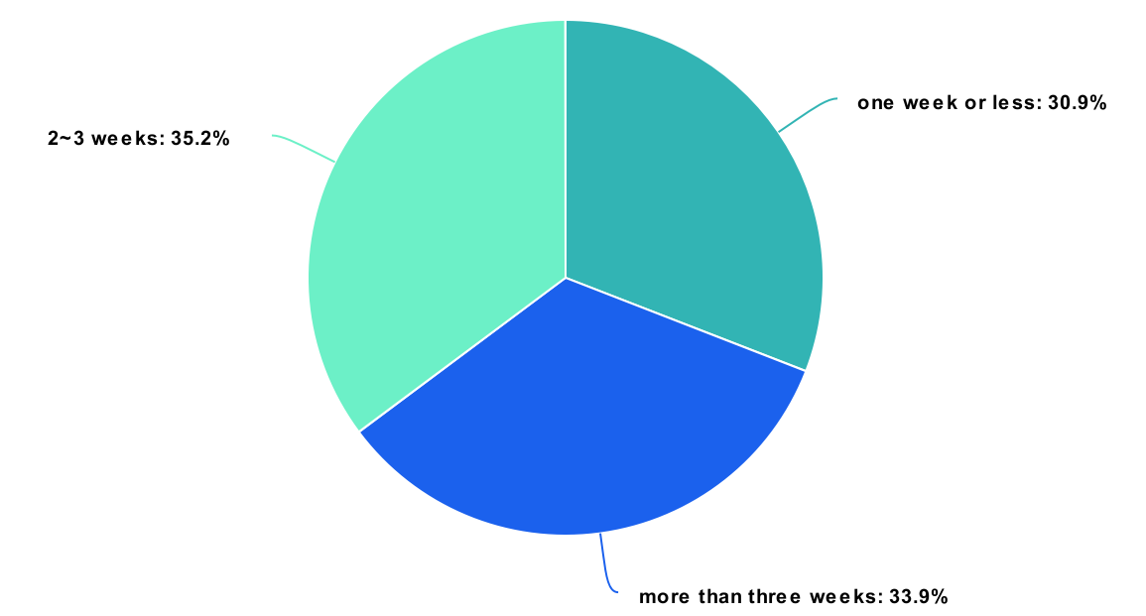
The needed time for students to be accepted by a Doctor as their supervisor

Slide 8
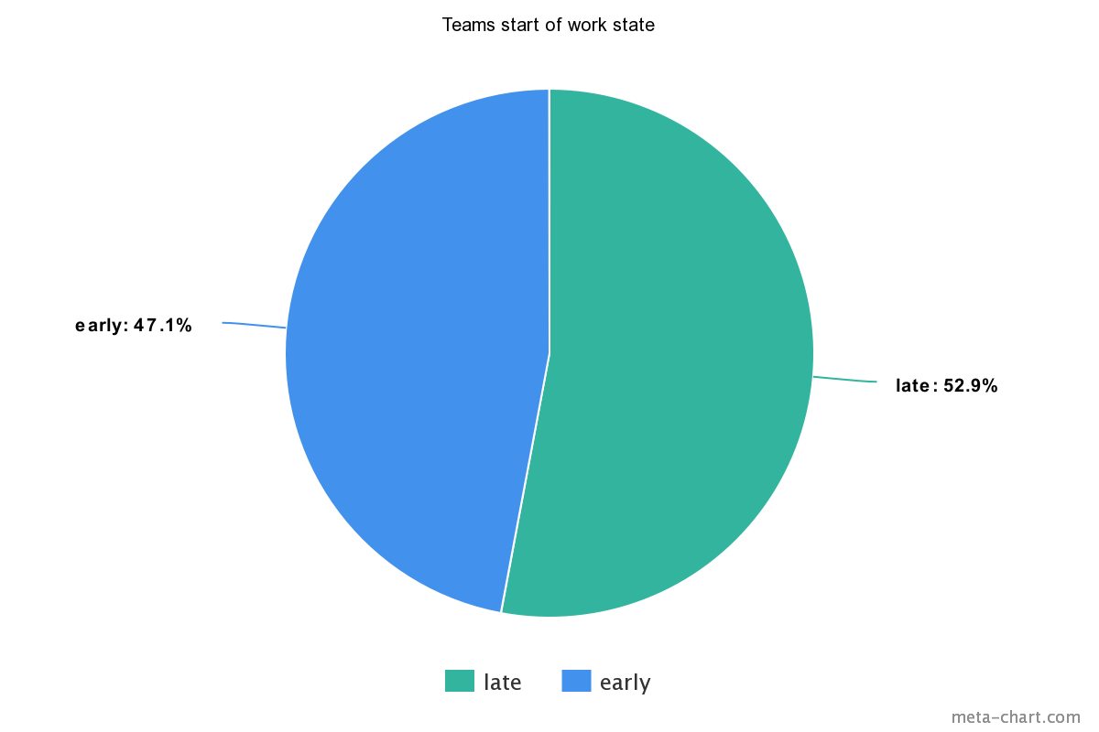
The percentage of students who submitted and started working in their idea early to those who started late

Slide 9
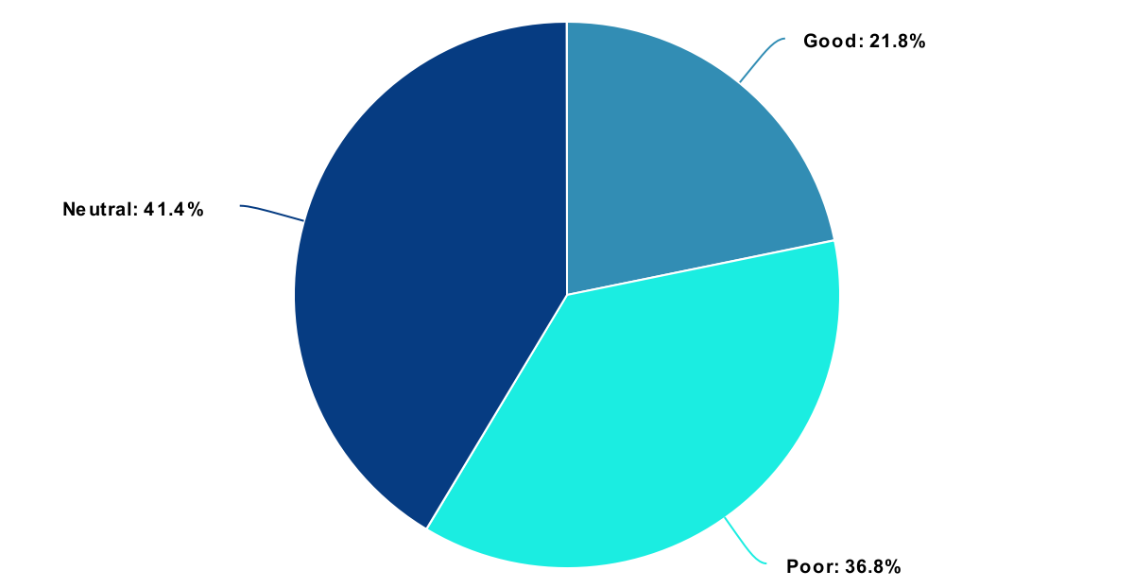
Student reviews of the offline registration system

Slide 10
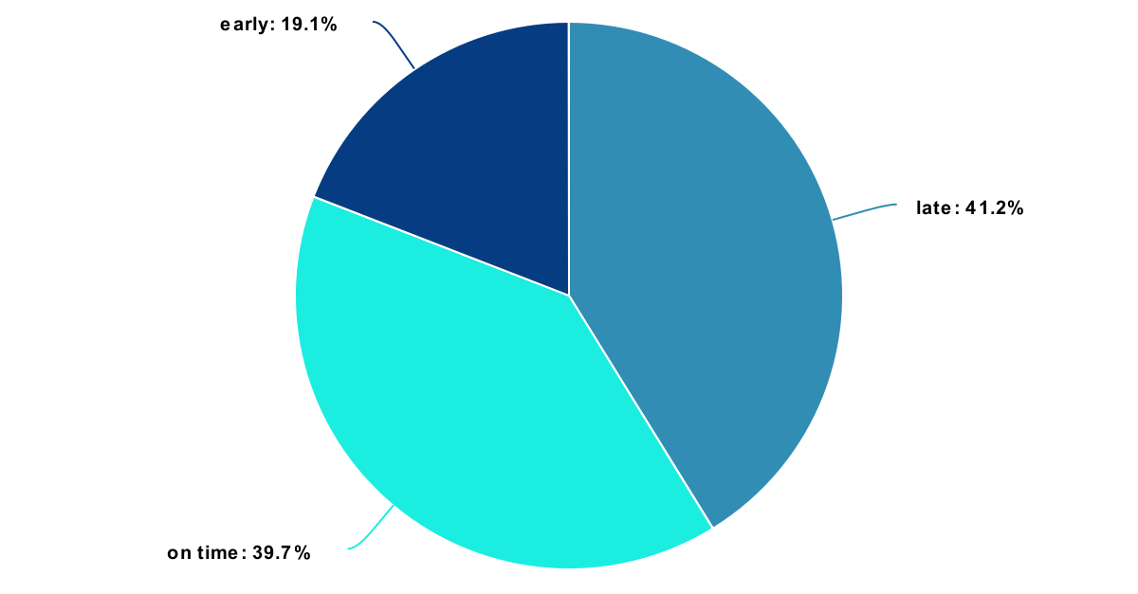
Students projects submission and work state before registration deadline

Slide 11

Project Idea
Developing a platform to facilitate the steps of finding a GP team and idea.

Slide 12
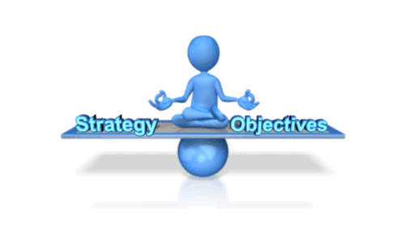
Objectives
Reducing communication by emails.
Saving both time and effort.
Facilitating choosing supervisors.
Avoid having duplicate ideas.

Slide 13
Related Work
The implemented systems cares about organizing what comes after forming a team and finding an appropriate idea.
No one brought the spotlight on the problem of forming this team or finding this idea.

Slide 14

Stakeholders
Senior Students
Professors/ Doctors
Teacher Assistants
Admins

Slide 15

How was the idea brought to life?

Slide 16

How was the idea brought to life?
The Idea was best implemented as a SPA(single page application, client side routing) using React and two APIs:
For the whole system: using NodeJs & TypeScript.
For NLP: using python and Flask.
Both APIs communicate with MongoDB as the main DB

Slide 17

Technologies
We used web development & NLP.
React
MongoDB
NodeJS
TypeScript
Python
Flask
Docker

Slide 18
Tools and Architecture
ReactJs
NodeJS
Python
MongoDB
Docker VM

Slide 19
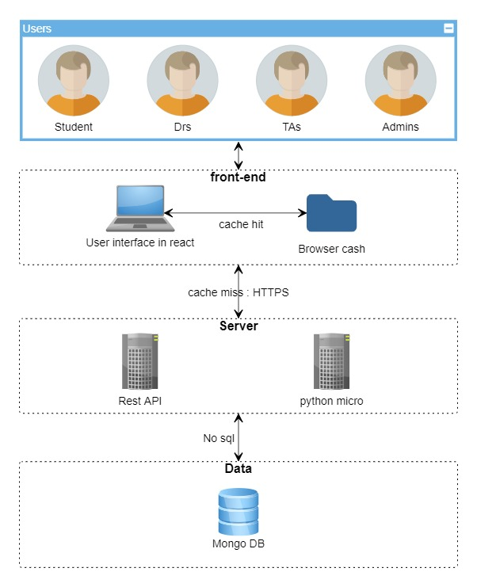
System Architecture

Slide 20
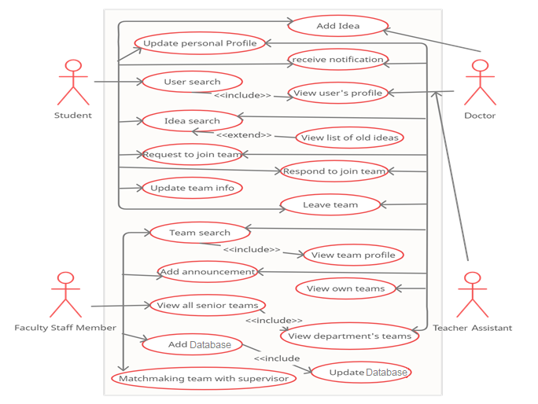
Use Case Diagram

Slide 21
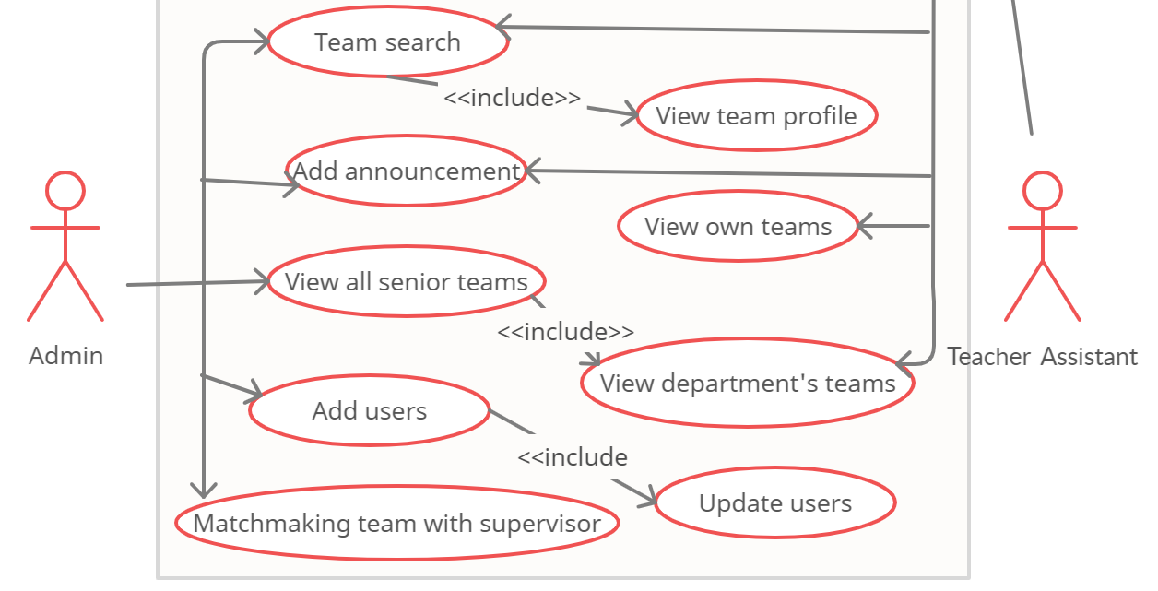
Use Case Diagram

Slide 22
Class Diagram
Part 1:
https://plantuml-server.kkeisuke.dev/svg/rLtTRzou4N_VluAuXqBRs46VLq5mJfoWAPeuY5Nq8GWAUPTEr6YbhQJrdS_n_rvIfCGXEVnIuYHt20wsE9mPpWn_C_oG_6i_bDrmtDUhrQTgHycswhOrNVMVg-PGTkMUREkoxy-6eQkkZWDzjMsRo-eFIlwsMeqjv9mokc5Fc-5bkHtQxfRShGWv_KY7LqqrL6NTPqsvfnlICnRDn_Nq0s5KZxOTBGUQiHy9WLGduvDz-VkRu_wATXVNbyDnnqJq6zACJso2uu5sDrNVTYPDrGIO00AS2TDPZN9rlrhPOtxy-CjJI2HiywOTgkjgMmvLsq3hg94FrL2hKHDctO5rLm_QtnhQlTe1wq6UaDMB_M6upKo2-nMcmwYjHYVqVTlMDTHJiZxRRkbXA6YvVqsvJTxH_nrfFsHCgT6W6o8jUq86HgJK5R_pU9dCoVJZGeZ9_BpbKXNZsH6Cz_npcFq9ENJjV-cMgVHM_712_28bML0oFjIbielo6mpLoPnHBX-MSn2McFOPLUE85O0etN_c6XSj--6yAzgY_4o_krU03X6-YH4xMOt11PnMuzGR6-IK4qeXi-xjyQgkjhBT08eTxRTTTU1JTtvcG0MZcT08mjV9GBUVchPkFrQKWLmn_NRx_iF9BIsxUG3hsM1A9H1PtqKXJ0VbXn-aoVtAy9bmgMoLRbLQ8fujpZ8zsv6hgbM_q6shpVm3O_XRs-t-NlQVT3peB-iMf3FY6G1nZ9d7gL9MwIZGyQVLytvbMtZq0w2Hhb3ihG9b5ovD30B5Z30TRDQZ3khnQbMnXDvTbrjApdQiqdX73srVpLem9PxT_gkd7HUJ7UKFGDxOAPyecSBLpcwzduRwkcq-jcrFJL7L_b1JRiOUrUBqTRkZzORiPVV7u-zFHjABAnxMv2-41SIHitXAxfXbTcrJtzxplaDNDlrrs-rf9nKgr1DkIBVcSslG0bnGJ-dkl1pAgxAdhCwvQQiTVrmrh89jjlIYU_4xJqjitcUbqbmoaCFumaAmhcUkzwPx9DauLvM-tFwFJDN6XrZ80t-OvX2CXrQ8qNBcIBhMj1MqBng6RxTPQuy63CFmlvetU11WxIjF92XwEnn0DDXU8fER7lNb3StOt8QJcWrWQZuUTdoskGcO6fGHQ44qjR4OEglhJ2lJttzmnXueqntnipF62_kOaQHQE2A0W4ATS1UmHHuqHkwpHkusHnvXZzmr0Z0lz6bXpWZFairijjTQ8uLxkMOsOmoO_jQwr9o0y_p3KytQzlROoPY89esrI5HsX2ijD1OQGA0lu92mY2D6FGs95TM5g8xSf39uHD2nq79qcMLpH8WW4_mk6cehgh7oK3ZD386SMuqvX_r_P5drxnZJ3RbgsvgMmWu6rciLvVZ4M9YFpuog4k0-rCGD_zoHbWEHGQ1vmAQpb_v6Ld248SWBda1rP0P4tSXImM4ZHkVNDpjqrGtp9OdXjYRnSonbYaNDi9G95Zk_ugPNnEmAJgwesWfn_vmODLFOqSZNm7WK6YrZzAb08dWWyavs0EPMs74wFDnqiNYO6RtNX3WZOTnX0Et5k9zZqxp_8AXGOq-p7OnkjYyGC0RuWVqkdaeFoaOPqrQpY81zU-C80A8878sYqE0i-vTjDqPZPczOoa5gnJRYOhSL8qpeDaB80YbZ25dCPp0zLOt-F9Y9AfY5Xji3tO3E1VizbockrFAGASijPLioSDsrUZwqHLl9ZbCPcrw2K6wzM8_wZJLiMLZSj0DzNR9YzsxQMGE2o67kf9wIUzvrnXHZMXfvLlExiWQQLbMp2hxJEpOnXsfx3rGf8FCBEMGrl2U2tzErFMQDeI0hMaMaQtBGqhlDtuYgQTSKAJ7DNL2aiFIHu9DJq4q4riwSluT8KDxQZqybDZi57hukgoRJTyKD3SMEwR-huTFBgcP64UTAo8QW155n_WDtFRK6VPTAz6H01adK2WB4fY9G8rRhBmvYgIe-Z2PW0INR-f_STiB1mK2SCuKLBHP77bG9vCzkbT5OXnxyuklsd4rSze1PyVcdilb8Ttnn3l6snsYkArhln2ypDLZvMFC-APKWddNYl0I6Oim-0DSn3yh4C6s0lje1zuzjC6JaUemxuUq4FhDP5BfByGR0CnpT8Lii6tJZHOJSgL8CTYYGfxo3BLZC2XYxSOB1X0XAPciMFNtPiAmxV8LdCaYZ-X2a4hVI1Yp6qPmIKOzhAfebEHRQIArksH-MwwPYMQ3lk1RqxqywCc0uHn9vel3izYT1JyP3r8fgwfgWkWhbTPASrqaSJfDG-YT_XeJ-q-JpFrqw9_5vcgJbQR8iJu_Jzn6s01-7Xa8gEhQ8VByatIEWZMKEYDjOUnnogvuOU5iWhSXndCOKoS8SH1PqmJMwMJ8OYaFEvkO9EA9reI0ywjLELU1vjTf-uT9X6uGocJnCaXE28v_ph4jRxLc3mme__NpctZuJTo-RbJcDOPc2qVB39D9jxXX8r9QG8i_TVib3VidJ_18uTTDtN3XCHVl4MKS3PvLxdvlA_MQaMM-0P8TJfcP9g-_AyIUHBYZtqC900zksMADhbypoQBdNDdeKg6YQQhXdZI46ycQ7UJUF3KzeA0V5PhvUQwzPlRkkc7NSRl1v8RJX32m2CBFSWmFMQUWgq-8UmTfNfb_sg5zKrnZlA6hSHvWYMPZ3Edol0RydQ4CwhyUOq_MBKqRDgoyX85PevPRE0o_MzDNtakK3C8XQGQY7-YKBQrZwlJ9HAsy_iRQplgzux0rzXlCJjyzShUv246FL9P4_RuyD5y26cs4sMC_riTv1hVrTtShcLXMePpTbLPTNDLtUSnGSfsDHHjl0YmhMV9GHex615S-bRs8eEgRNfUEgRQ08iZIAIhZW6kFuknwvdfjTyj13lyy8ZcRW0tJ9f5WOp-1T5Ai2G759vBQqdQZ43J1KRfOWCcNRQmMlvZWHrNGuMkUOHERTKJI0q6CJBxBdSSYUHu9adWHlUJIcvgdGbY-0cdmH7ERBC21VZAB-_98dvemy4L_pM6ZCltqn4BDpypML08Shep0KPxcEgj1gZ2lLPR-eUb2GEef1KtuMw8kLWKOLQB_g0kwJ1wzQoBX0k5Z9qdx_fFgfoydrhAdQTXQOCkE74pwCcSkdMHyam9bVCgtgoVDHDAWWuiTpqJMynwai0XJFrih2mMfCcmhpCaq-DjASHdldA7g2XTAY4pzlAONkUDYpxtiKEvRGb4ediT01Bm7Oyrrt5bxXG18OTVfE58wo0QZ9Kx4c3qDW7ZDdSjTCo4C0cXkWejSa6YJeJJWaX4gQzKPLBt6OaSV2LmHU_3p5WQwL1ZY_yCjAP-C1nvFYwI-a5BUqn1Fv3dHtR39nSwrGMOxV58QlvTYl1_FyExr6hLj9F9CrUzjtPeiylGMFPyY1-ZfacgFu3wGZrfWSNDGorYdOU2dP9tiYTOf7U8Krc5-1zOWkIfTChNU4CFEzSf_GcTOf7ECMfqIqrG6nJur5beSlLVjK6EcSqaqkNi71zwznFTpT4BMYPCHgMPHyW73b7gUcsS-lfqUAJr5BWpUj1NhZLHIUgHKPUVBbz1JhvgE141D1Ds51cBGe8sZccHP76ozyZ5uldJkSOhkPtfrVsRHHstmt0JE-l93MQxj96_piOwGygEjB6_kIrKY3VHb3tYOZ94RIoKpjboRevBsps0HclEteJZVolD9CrAuqxKlIk12_V-QWJt3HIOoFE16kaF1IlA2m7F4UKq9oDnS2I6PEyelXWfcHr_Pi4gVE2_FpA34TrsZSElAVRHEiO73Pfg6_2LgFQKn-VXCf49rCfPPi6tlzDjzZ5SVD6-EyMyMa_RKU4PGHt7tC7I0HgBfGety7fB3519tna6X1d6ez26AiKkjI5DAjMlAhS0Coy_j2504BySFnQI8FXZZCvIwaeQ6YgbjvgkI8PUl59pp0RSih2mUrS1dSKqsbJuCe_8gPAwS7-PBWndXT43JBpwviu9VBv4mBVrKgSSx532ncNFvX-KPb1sdAieguWzQpr95HYqMdAvHZ0jGXCI92hSBzeKBqMqMVOwWF4duF4rfHA-7finljctRWvz4ELyBLyBGMHgwbFc-ReUDNfETtVVGDTdnhNLB6N4-M76TxM9zoMedbkhXkfrhxh1EZtn1fXXFIqVxGDZtbZyHFwxcpwfdIiTpjKZiIqPFkgeKonKM6HNrFUzfLPLtzGL_ow11DuliruE8jzpFguR-oPJhgpWXgwDK8yicvwcQj7Md-cUP7XmVO1fZqAO9dsufV4NoDIjEoYBb6wG4z4Nkd_BCPSpFotL559SQBV-13N-6eapJuEv-SujzuC3I6Pz7-ewqQJfSIzUSJcXKj6pWVzvH1KxZiuTf7v679JNscaCJmEvdciU0uep3dUDwbgwGnACeK1dFT-rMMqLvC4WTxYRrbf2VwTSBjT85JD_7oMMBdYqP-jtE1lgmlM9ubgIqXuf-qlA6faXKCf7RdMqm6X7AqjI4J8J9W4sE3WIR6oK9Djqvwjd2n2b3X0EaOumHzI3E6a04o_o0DZ3JlZjgPBlv-G-hhqrWUdEZTsR0tl-cviJ-akZHtHMNr7vMD-MqLy_EsaGc3Y7uRylBOZ9MrI26d0id0Iw7sf4QuwU-HMapHEiznHrRSsVXOzVoAGYmUgI_aHXUz-WThemM9SXUOExgdp15dVMgNwTPfOhSenw6tDDVQLRLeiVn2I9EaPLgUVJH-G-m5MwaiCJzVuIGfnsRSTLNJ-AI6GYO7M1GPdTGeBZgfKLICe9vWCO8KOewRt8969wcDa26kKHeW28bUs7-nRLbX-vasOpgphpEwBYkQjnp5r56N4BKxY3yWQPeESAQhb5GKMazDIwaKl0PR3aaTnkd_NAGxeMvwzn4zbdO-5zY_eBiBaVrTuk5NzKb2BUBPXh7kP4eP2IZFj-Zi-U16H9GKXqEK5C4W7vs6AWxPMhHR5sI_3PIONoooiIEcmEHu4ThYPFe84ZVinDIxh78RWZjKhVRN3ZR6Nwn0jbpn_IOOsF6R2A2RzkSmqgRyRbAfZL_TWixVH79ggUCOUP_QM-nbBEoCV5DcYVobVIyQ-yzzf34HrzZjlncIpWF-xPFqtijZo5odBEUnT0IYzw8HUDAIzIKjzOTLWcKcJeV29KwAmYPEQaEdWmv3KE-0veCczj-ljDaTz_N_0G00.svg

Slide 23
Class Diagram
Part 2:
https://plantuml-server.kkeisuke.dev/svg/fPP1RiCW44NtdCBBf4qka6nYjSgoYwGNG6OI8M5mO5ofhNhtGd0CZd55dQp8yCOC_tzBtXca6jjQ448gGOqftXJo4wyeSYLVb4IjX01TV9F2_jOosZr0epO3tbKCHwK_Lnv7JQKvALs37fBlOMD5hkpp6R0K8eRCGiEb1OERuk0NgqA3QUmEk99VBGlVpq00Gjm_e_sX2JHGDljyrpptT2-s0Ssfu5-mL_gskM3G39LVaXz29an-Mgyd_CpjY7pj4_KAZSrO3HB7URBZ-HW5A1owxPbkQqyhLu_fhhHDv2r0qLGMz7fJnWBmBwU0SPpPwZCUckSaVDxHVwGZFD2oDXmaQPXpEcLI3jsPb8CE0kJpKqgfMbb1Ea4qslLHAkygtPpZWCJWuDnRG68WJ-pOvhZRFEvLVD7XxDws2PcSl1EAP7QaB64rbqUawJTwb97qwztTjMr0U-EERld1ZT8Z25lM-tiCVpnZYIlMY-ycorJygfoxJKxKKs1ow2HuFtQiPIBNhXnBM0uB_h92dRbyxARtpoKxaCn-4Vm2.svg

Slide 24
NLP Models Dataset
Collection
Surveys
Old databases of registered projects
Cleaning
Extracting important information from collected data documentation
Pre-processing
Nltk
Contractions

Slide 25
NLP Models Description
Short-length documents
Good semantic analysis
Re-train with each addition
Score based
TF-IDF
Doc2Vec
Long-length documents
Better semantic analysis
No need for re-training
Word embeddings

Slide 26
Time Plan
Fulfilled Tasks / Future Work

Slide 27
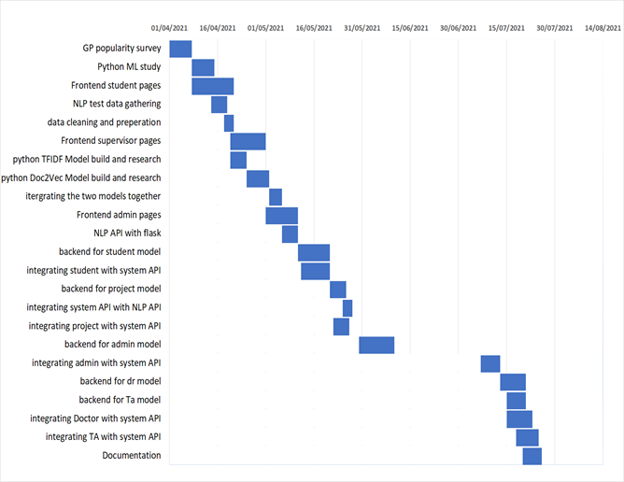
Fulfilled Tasks

Slide 28
Future work
Matchmaking.
Specified target announcements.
Ability to co-supervise.
Registration deadline.

Slide 29

The problems that we faced
Problem 1:
Couldn’t find a data set of projects’ description to train the NLP model.
Problem 2:
Integrating MongoDB using Flask & NodeJS.
Problem 3:
The lack of a strong OOP in JavaScript.

Slide 30

How we solved them
Solutions for:
Problem 1:
Manually collected a dataset from surveys and old data.
Problem 2:
Used Docker for container management.
Problem 3:
TypeScript migration.

Slide 31

Conclusion
Developing this project:
Saves a lot of time & effort.
Facilitates searching for a suitable supervisor.
Prevents having duplicate ideas.
Enables using the old ideas as a reference.

Slide 32
Demo

Slide 33
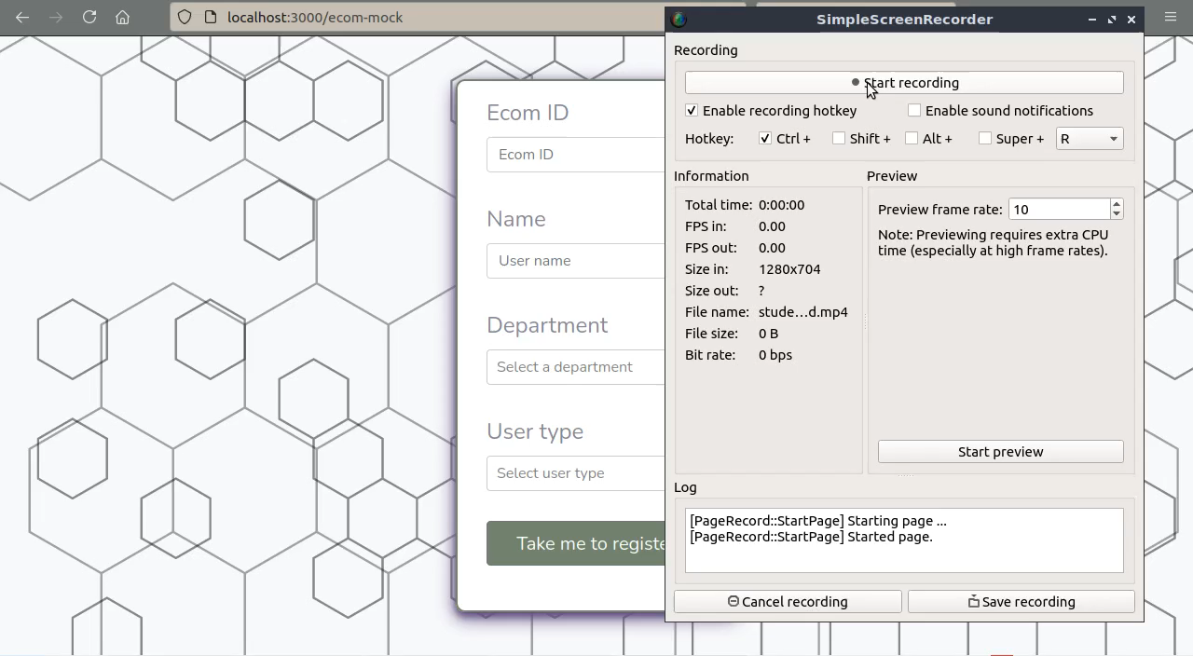
Register

Slide 34
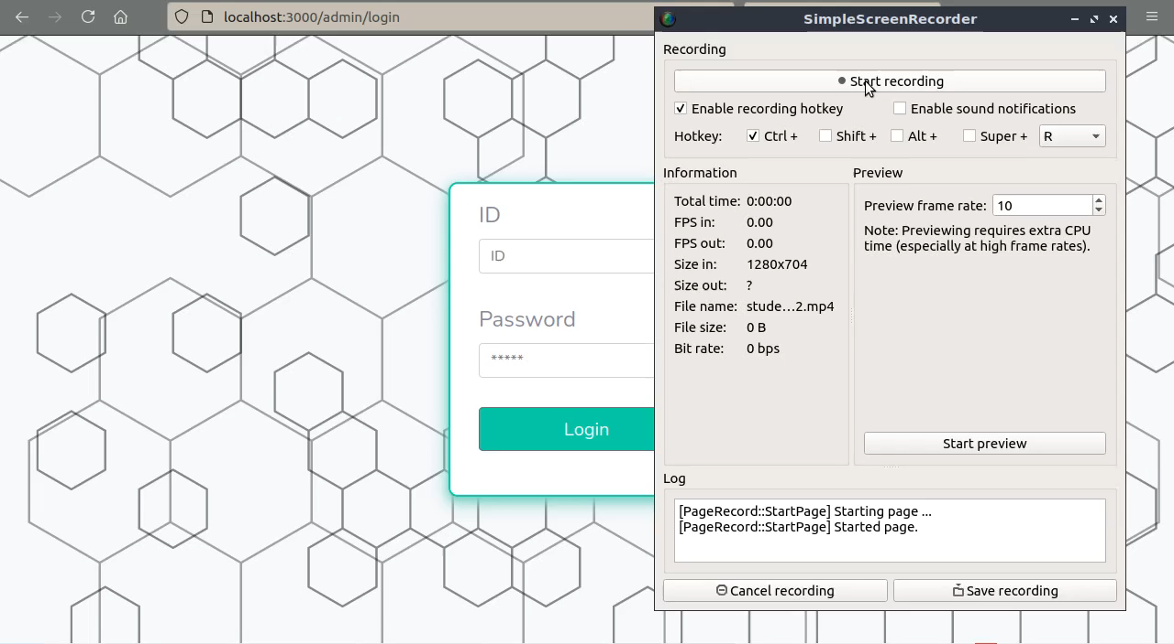
Admin

Slide 35
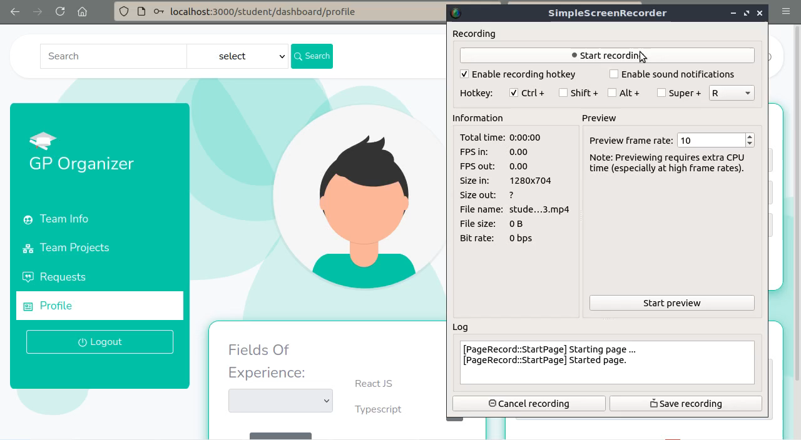
Student

Slide 36
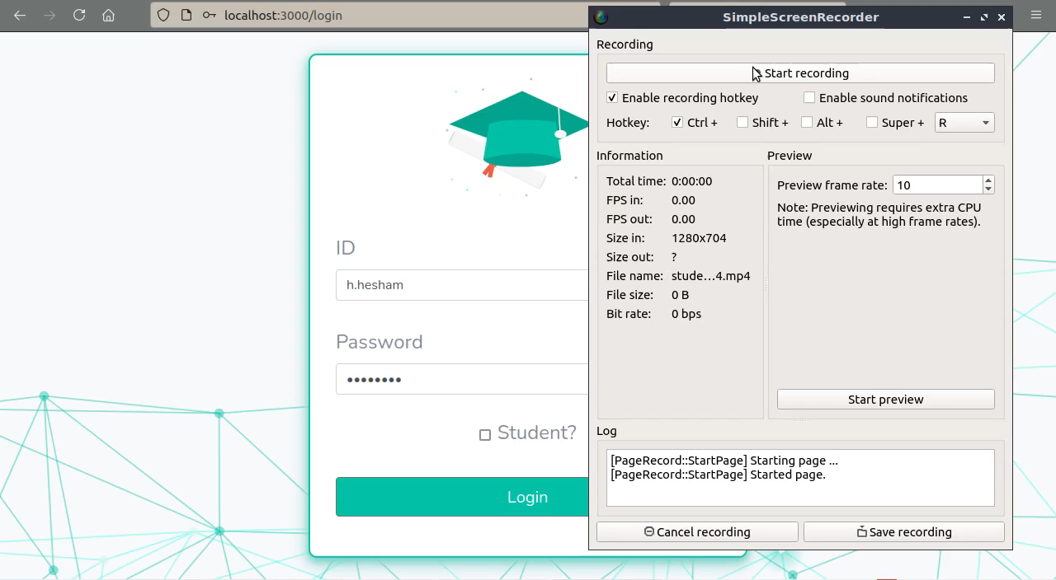
Supervisors

Slide 37


